Slide 1
Vendor Performance Optimization Analysis
Bibitor LLC – Wine & Spirits Inventory
End-to-End, Database-Driven Analytics Project
Project Context
  Data fetched directly from a MySQL database to simulate real-world analytical workflows
  SQL used for data extraction, aggregation, and creation of analytical tables
  Python (pandas, NumPy, statistics) used for data cleaning, feature engineering, EDA, and statistical analysis
  Power BI used for interactive visualization and business reporting
Nature of the Project
  Designed as a real-world simulation, not a static dataset exercise
  Covers the full analytics lifecycle:
  Database → Analysis → Insights → Visualization

Slide 2
Business Problem & Objective
  Bibitor LLC manages thousands of vendor–brand combinations across purchases, sales, and inventory
  Key challenges:
    Which vendors and brands truly drive revenue?
    Where is profit coming from vs volume?
    How much capital is locked in unsold inventory?
  Goal: optimize profitability, purchasing efficiency, and inventory utilization

Slide 3
Data Overview
  Dataset size: 10,692 vendor–brand records
  Integrated operational data:
  Purchases, sales, pricing, freight, inventory
  Final dataset built at Vendor–Brand level
  Used for performance, profitability, and risk analysis

Slide 4



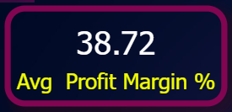

Key Metrics Engineered
Total Sales
Gross Profit
Avg Profit Margin (%)
Total Purchase Amount
Unsold Inventory Value
These metrics enabled multi-angle performance evaluation.

Slide 5
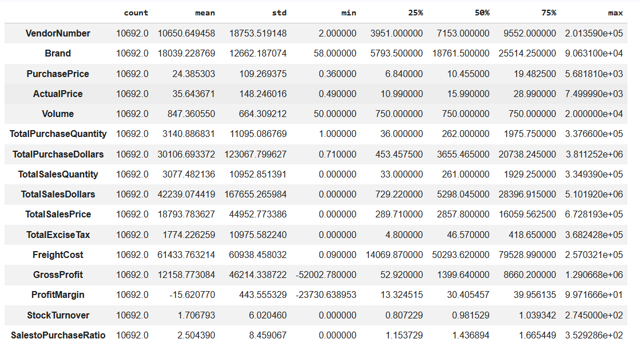
Initial Data Insights (EDA)
Losses exist:
  Gross Profit min = –$52,002
  Profit Margin ranges down to –23,730%
Zero sales observed:
  Some products purchased but never sold
Indicates:
  Pricing issues
  Overstocking
  Slow-moving or obsolete inventory

Slide 6
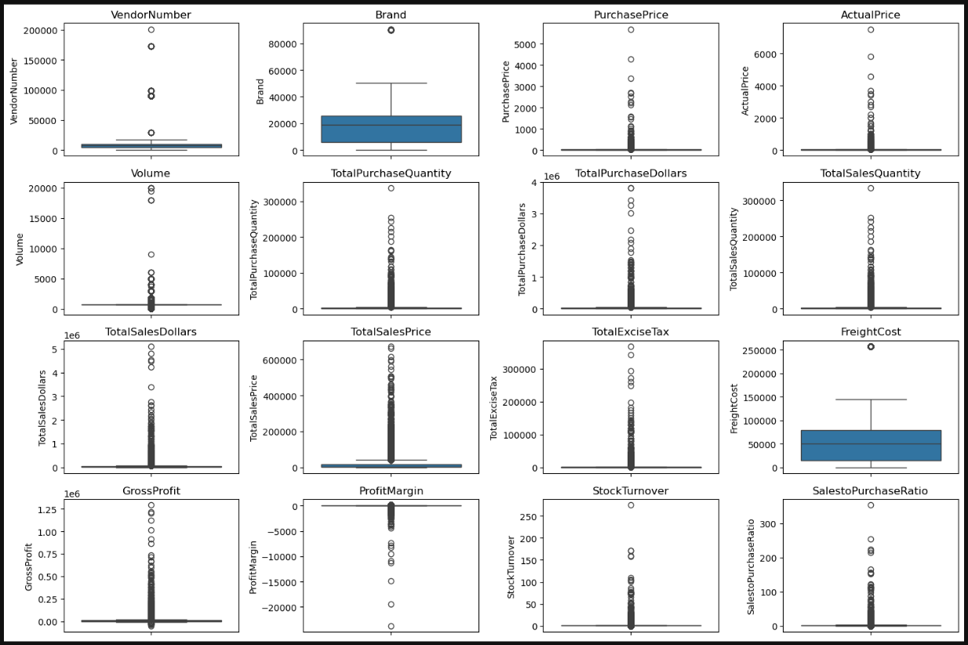
Outliers & Variability
Purchase Price:
  Mean = $24
  Max = $5,681
Actual Sales Price:
  Mean = $35
  Max = $7,499
Freight Cost:
  Range = $0.09 to $257,032
Stock Turnover: Range = 0 to 274.5
Conclusion:
  Highly skewed distributions → averages alone are misleading

Slide 7
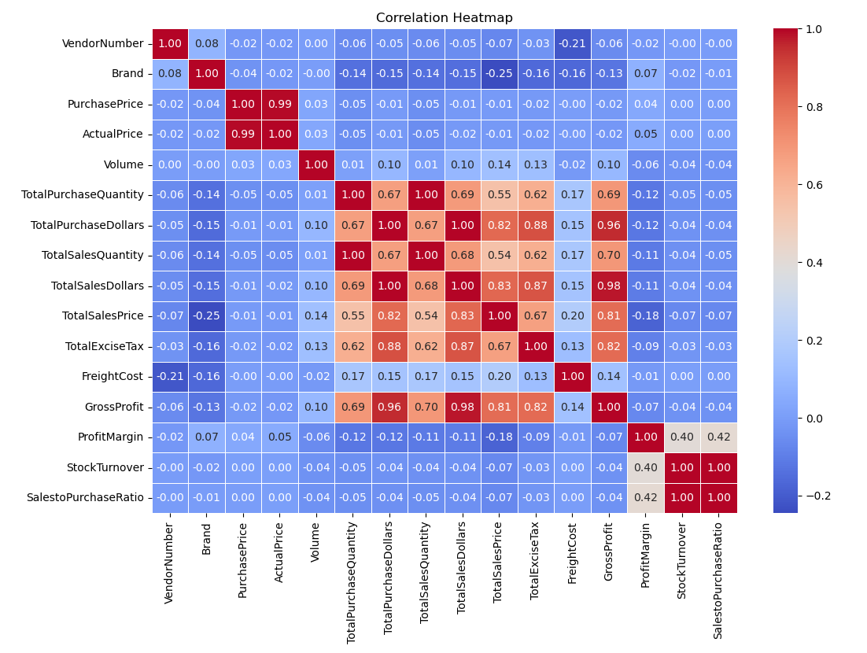
Correlation Analysis
Key findings:
Purchase Quantity vs Sales Quantity: 0.999 correlation
  Inventory flow is operationally efficient
Purchase Price vs Sales Dollars: near zero correlation
  High prices do not guarantee higher revenue
Profit Margin vs Sales Price: negative correlation (–0.179)
  Higher prices often mean tighter margins
Fast turnover ≠ higher profitability

Slide 8
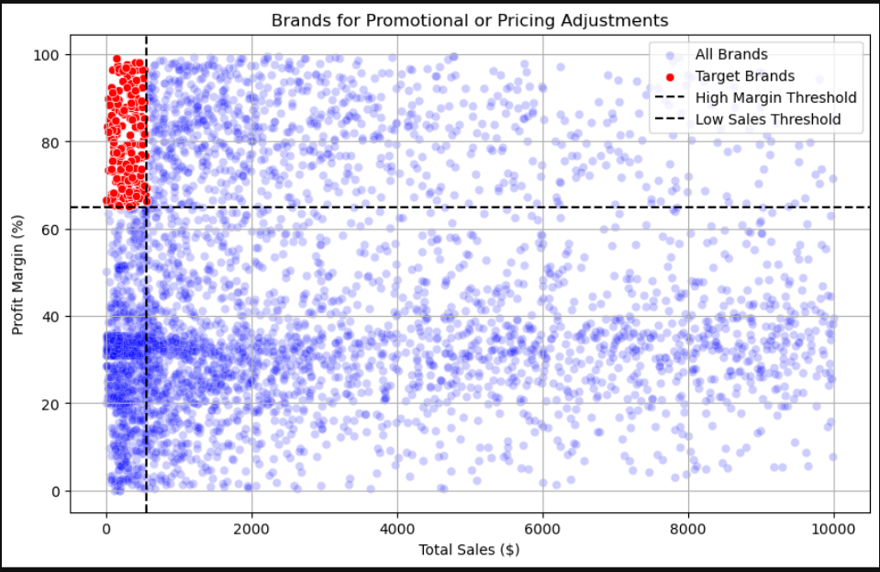
Brand Pricing Opportunity
Low Sales + High Margin Brands
Bottom 15% in sales, top 15% in margin
Profitable per unit but weak demand
Actionable insight:
  Promotions or repositioning can unlock volume without killing margin

Slide 9
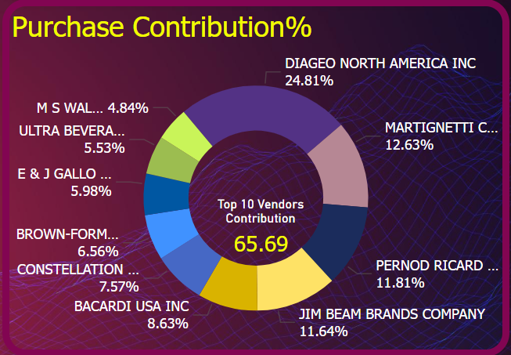
Vendor Dependency
Top 10 vendors = ~65.7% of total purchase dollars
Strong dependency on few suppliers
Risk:
  Supply chain disruption
  Negotiation leverage imbalance

Slide 10
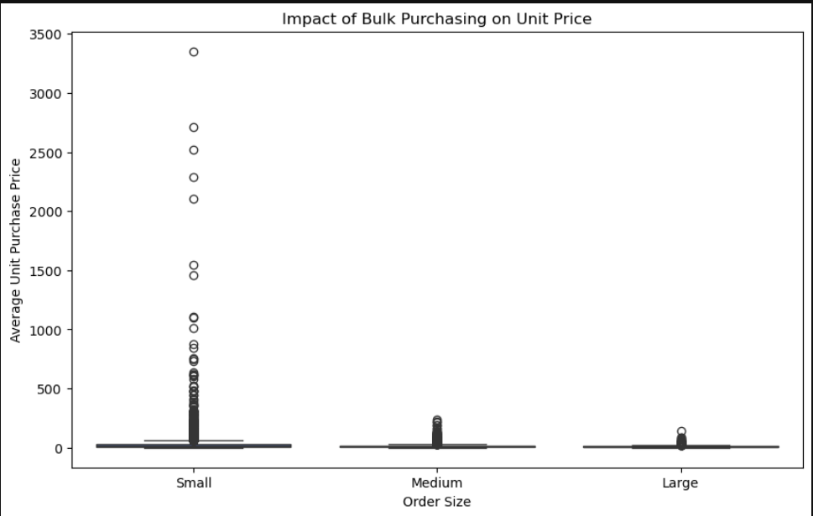
Bulk Purchasing Impact
Order Size vs Unit Purchase Price:
  Small orders: $39.06
  Large orders: $10.78
~72% unit cost reduction
  Clear evidence that bulk buying improves margins

Slide 11
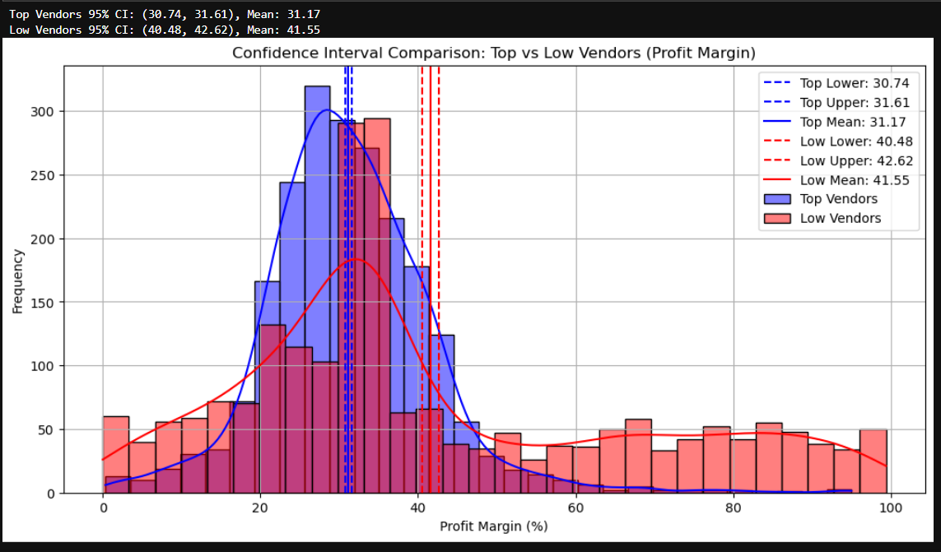
Profit Margin Comparison (Statistical Analysis)
95% Confidence Intervals:
  Top-selling vendors: 30.74% – 31.61%
  Low-selling vendors: 40.48% – 42.62%
Two-sample t-test:
  Statistically significant difference (p < 0.0001)
Insight: High volume ≠ high margin

Slide 12
Key Conclusions
Vendor performance is highly skewed: a small number of vendors drive most sales and purchases.
Profitability and sales volume are inversely related:
  High-volume vendors operate on tighter margins.
  Low-volume vendors often sell high-margin niche products.
Inventory inefficiencies are costly:
  $2.71M locked in unsold inventory.
  Several vendors show Stock Turnover < 1.
Bulk purchasing is a proven cost lever: Large orders reduce unit costs by ~72%.

Slide 13
Short-Term Actions (0–3 Months)
Target Low-Sales, High-Margin Brands
  Launch focused promotions, discounts, or bundle offers.
  Objective: increase volume without sacrificing margin.
Reduce Purchases from Low-Turnover Vendors
  Freeze or cap orders where Stock Turnover < 1.
  Clear slow-moving stock through markdowns or channel transfers.
Renegotiate Freight & Logistics Costs
  Investigate extreme freight outliers.
  Consolidate shipments where possible.
Rebalance Inventory
  Prioritize replenishment for top-selling SKUs.
  Reduce exposure to low-velocity products.

Slide 14
Final Recommendations
Do not treat all vendors equally — performance varies drastically.
Focus on:
  Volume efficiency for top vendors
  Growth activation for high-margin, low-volume vendors
Use inventory turnover and unsold value as early warning signals.
Combine descriptive, diagnostic, and statistical analysis for confident decision-making.

Slide 15
Final Conclusion
This analysis demonstrates that:
  Revenue, profitability, and inventory efficiency are distinct dimensions.
Data-driven vendor segmentation enables:
  Better capital utilization
  Higher profitability
  Reduced inventory risk
By acting on these insights, Bibitor LLC can:
  Improve working capital efficiency
  Strengthen supplier relationships
  Drive sustainable, profitable growth

Slide 16
END

